Slide 1

OYDER Automotive Congress 2016
Parvi Group
an experience from Brazil
Bruno Schwambach
CEO
Parvi
bruno@parvi.com.br

Slide 2
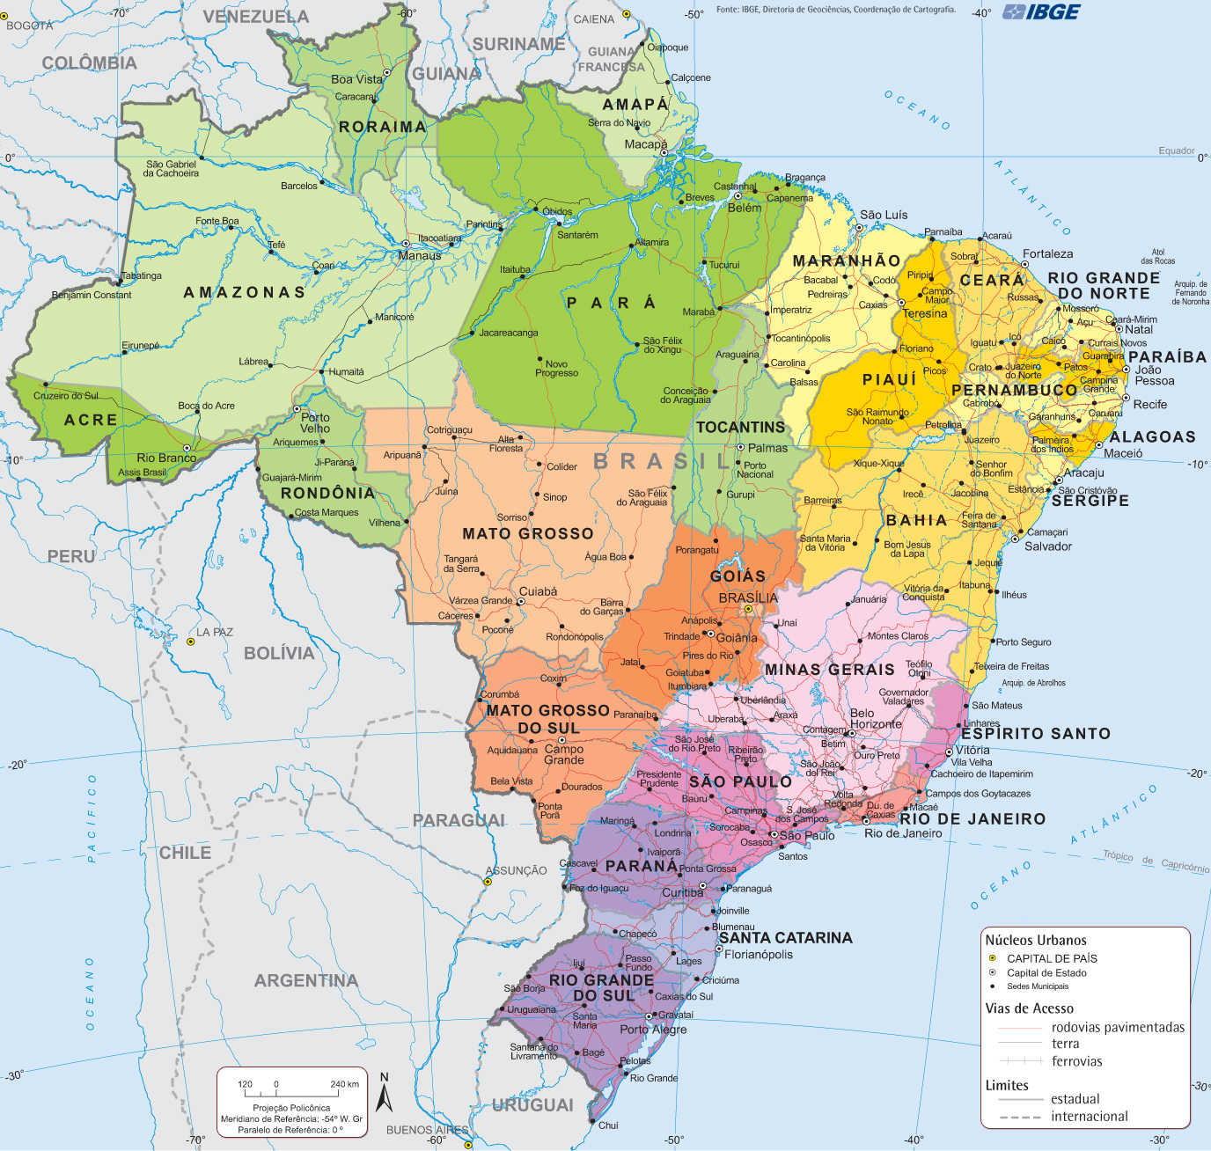
BRAZIL is a BIG country: 8.5M sq. km;
~ 11+ times area of TURKEY;
~ 2.75 times population of TURKEY

Slide 3
Brazil Overview
Population: ~ 205 million (5th of world);
Area: 8,514,877 km² (5th of world);
Cars Sales/Year: ~ 2,5 millions (6th of world);
Brands in Brazil : 42;
Brands with plant in Brazil: 23;
Dealer Network: 4.000 Dealerships

Slide 4
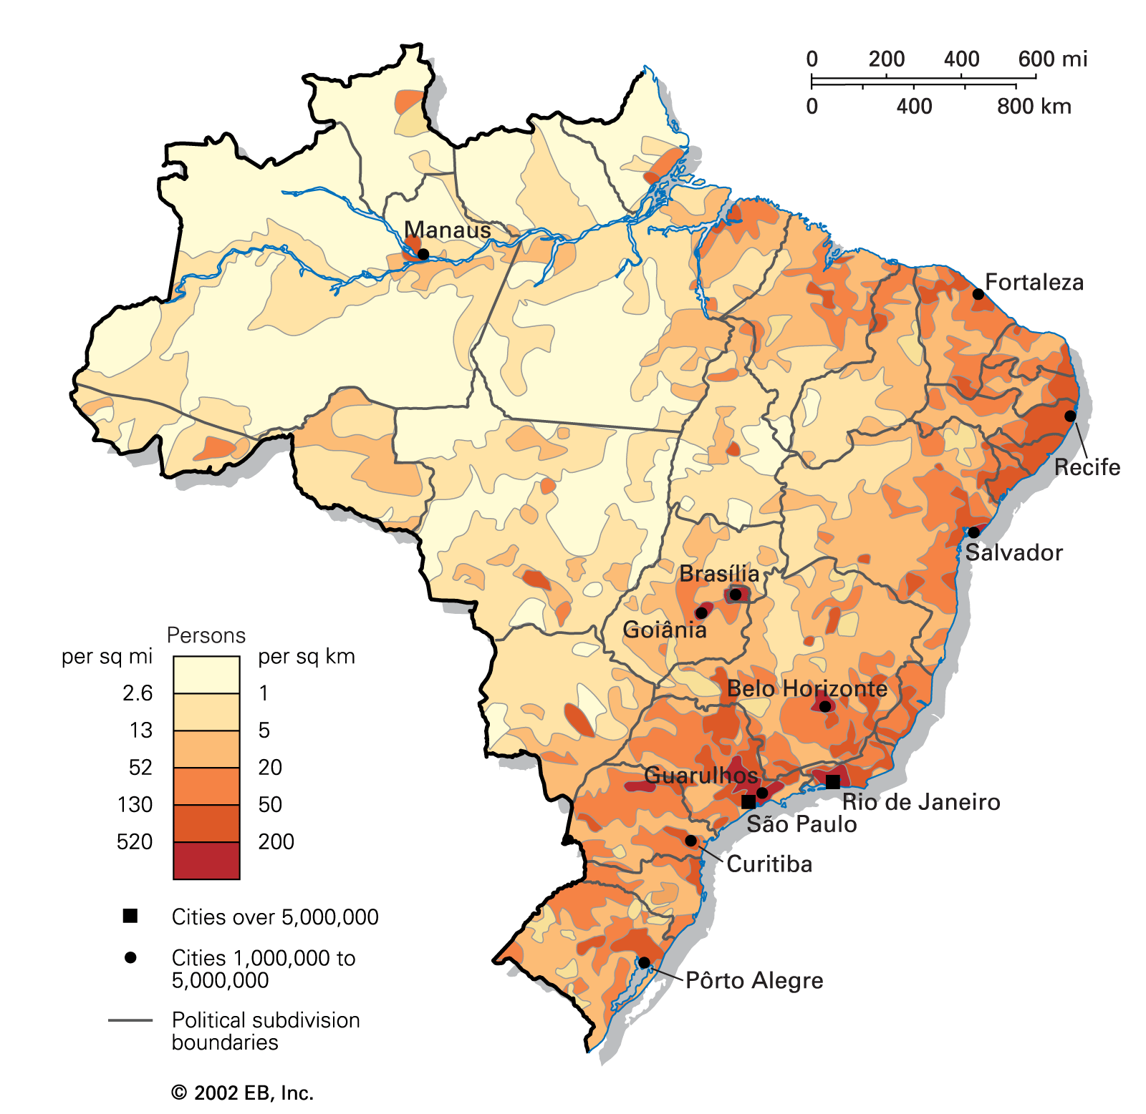
Population Density

Slide 5
Cars and Light Trucks Sales in Brazil (000)

Slide 6
Brazil has:
opportunitty to sustain growth;
Country | Car/hab | Population
USA | 1/1 | 318 M
Argentina | 4/1 | 40 M
Mexico | 5/1 | 100 M
Brazil | 6/1 | 200 M
But,
Biggest cities of Brazil already have from 1,8 to 2,5 cars/habitant.

Slide 7
Brazil CENARIO
  INFLATION OF ~ 9% IN 2015
  NOMINAL INTEREST RATE ~ 15%
  REAL INTEREST RATE ~ 6%
  GDP DECREASE OF 3,8% IN 2015
  UNEMPLOYMENT OF ~ 10%
  AUTO MARKET DECREASE OF 50% IN TWO YEARS

Slide 8


Slide 9
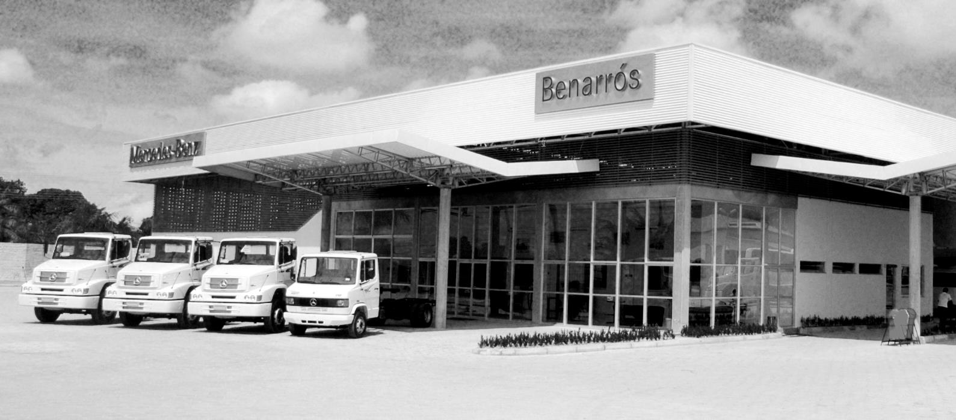
Parvi Group - Brazil
Private, family owned Company
Began: 1980 – Mercedes Benz Truck Delaership in a small city in Northeast part of Brazil

Slide 10
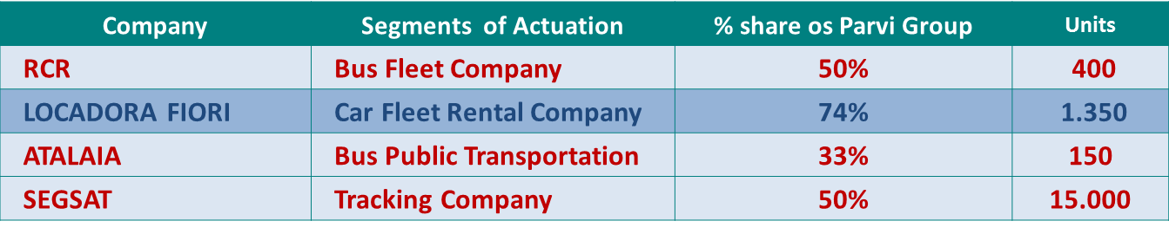
Parvi Group Porfolio
73 Dealerships [19 Brands ▪ 13 States ▪ 23 Cities]
20 other Facilities to suport the Dealerships [body shop, PDI, Recon Center, used car store, etc.]
93 Total Sites for the Dealerships
Parvi Corretora – Insurance Broker
Parvi Consorcio – Consorcio “Brazillian alternative for financing cars”
Other Companies:

Slide 11
the city of RECIFE influences a gigapolitan area, 500km wide, from NATAL to MACEIÓ [N-S] and a large area to the WEST, in 8 of the 9 states of the NE

Slide 12
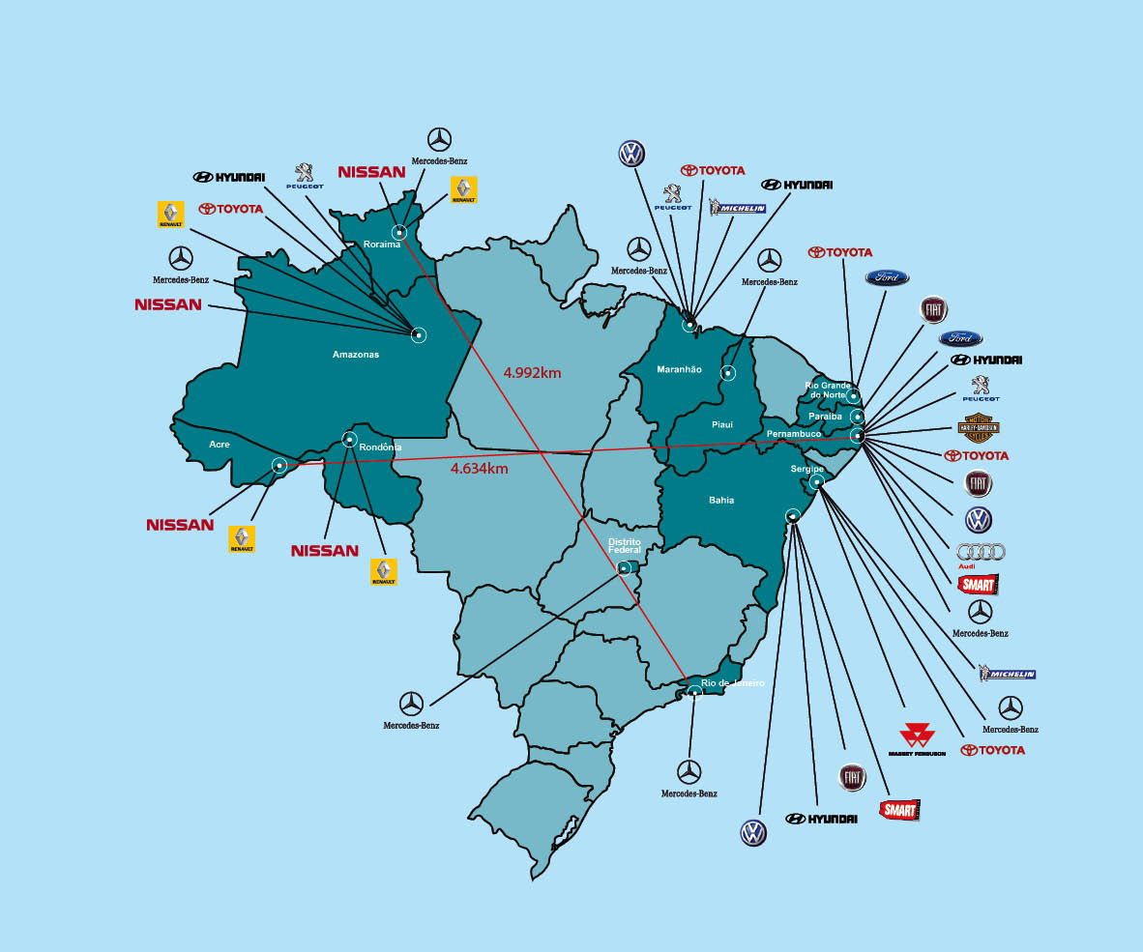
Parvi Group
Brand | Dealerships
HYUNDAI | 8
TOYOTA | 7
MERCEDES TRUCK | 10
AUTO MERCEDES | 2
RENAULT | 3
NISSAN | 3
PEUGEOUT | 3
VW | 9
AUDI | 1
FORD | 7
FIAT | 7
Jeep | 8
HARLEY DAVIDSON | 1
Land Rover | 2
Jaguar | 2
Total | 73

Slide 13
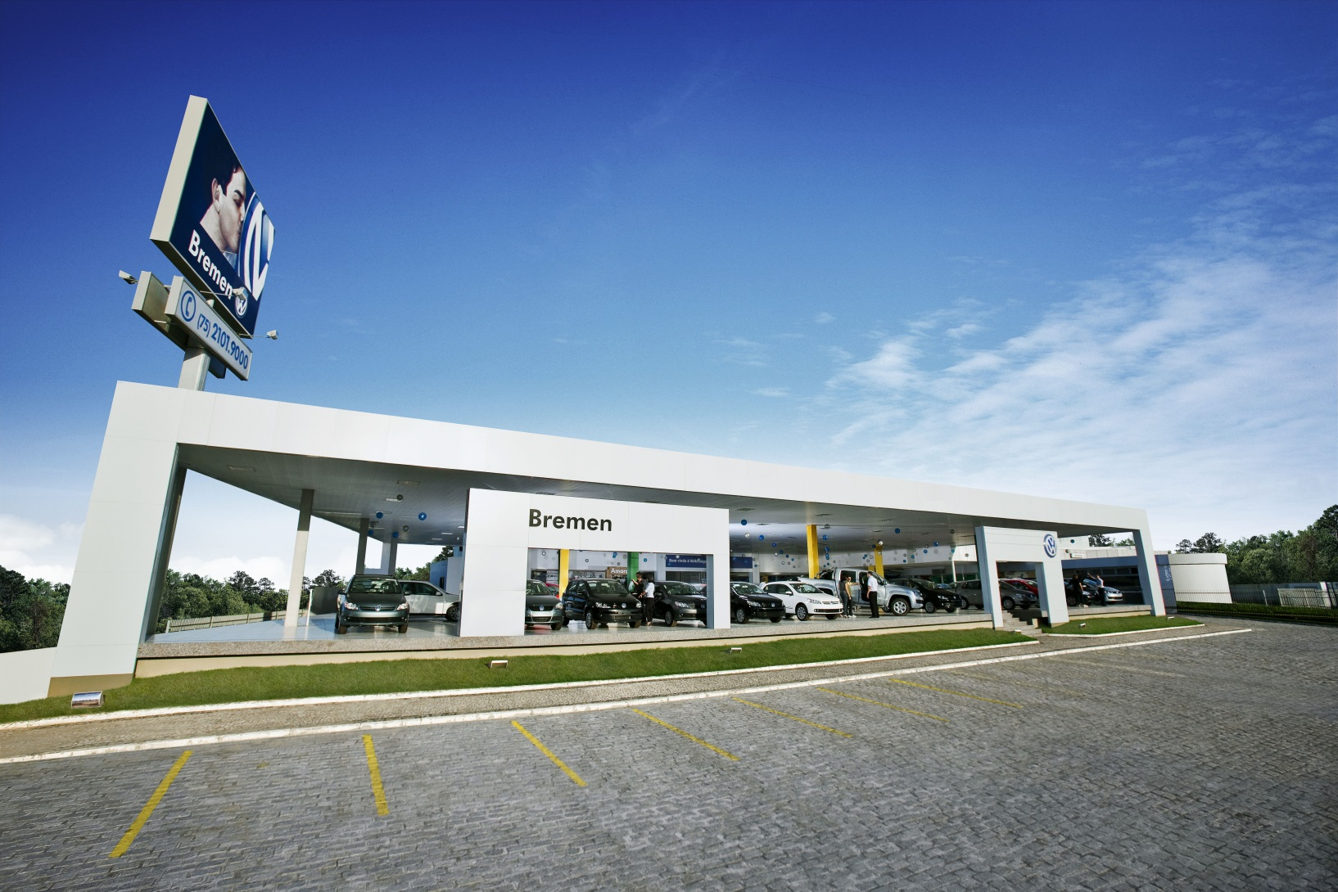
Bremen VW
Feira de Santana

Slide 14
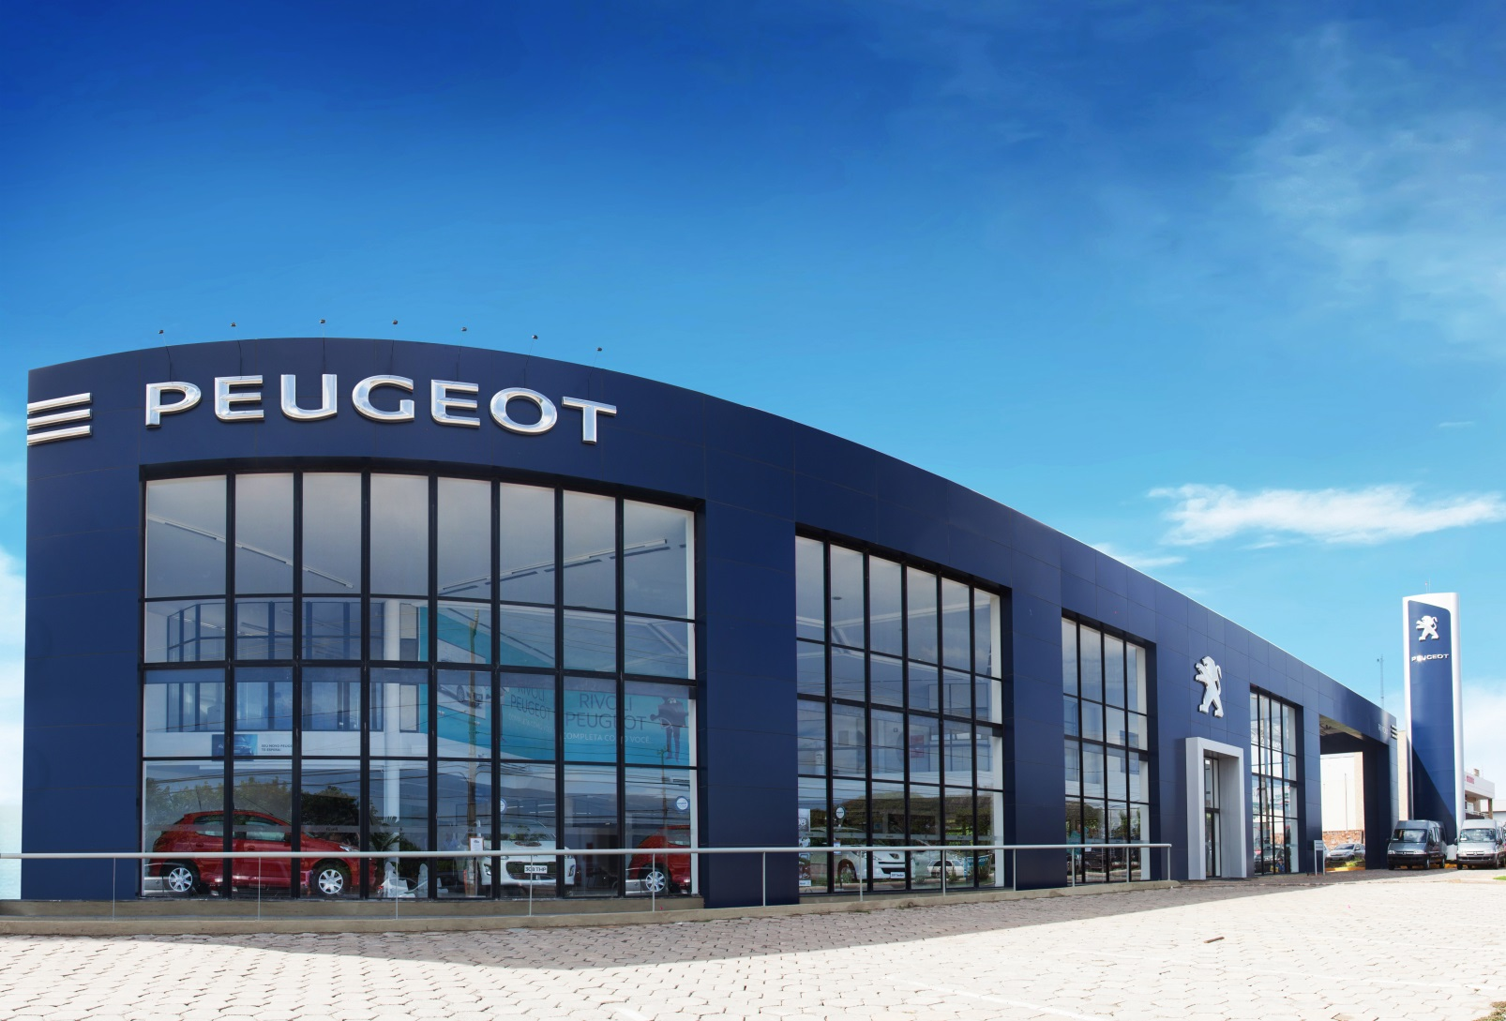
Rivoli Peugeot
São Luis

Slide 15
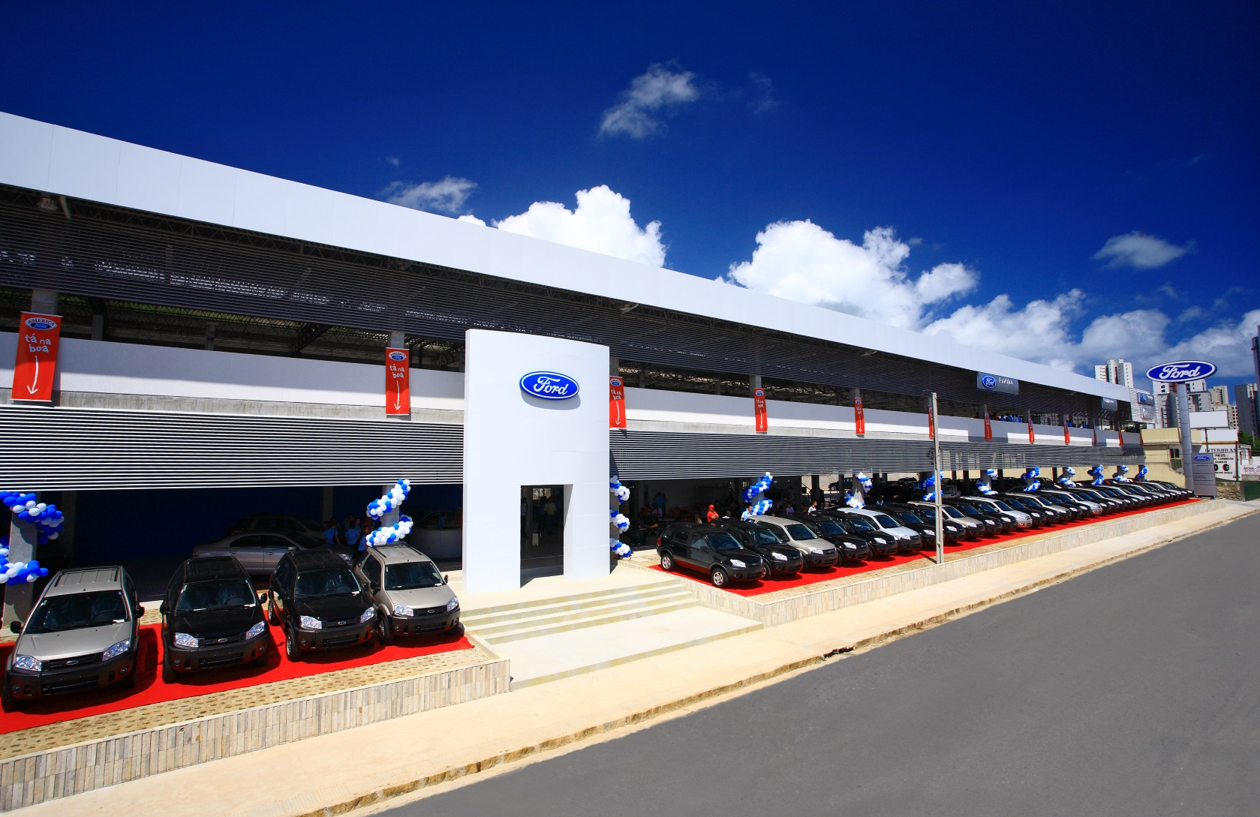
America Ford
recife

Slide 16
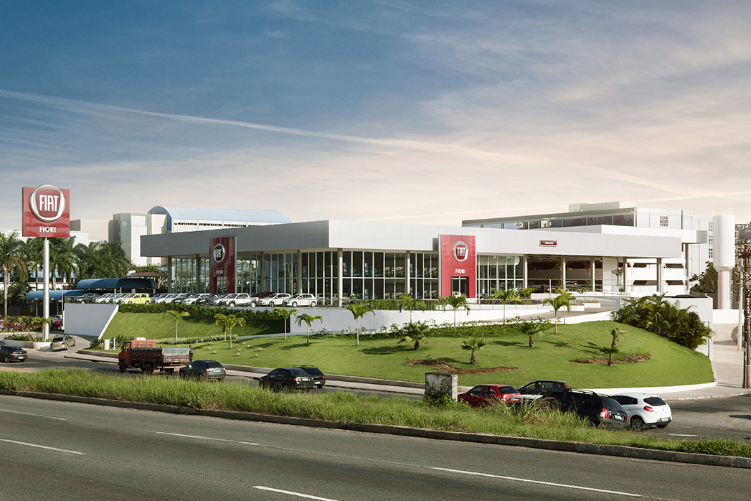
Fiori Fiat
salvador

Slide 17
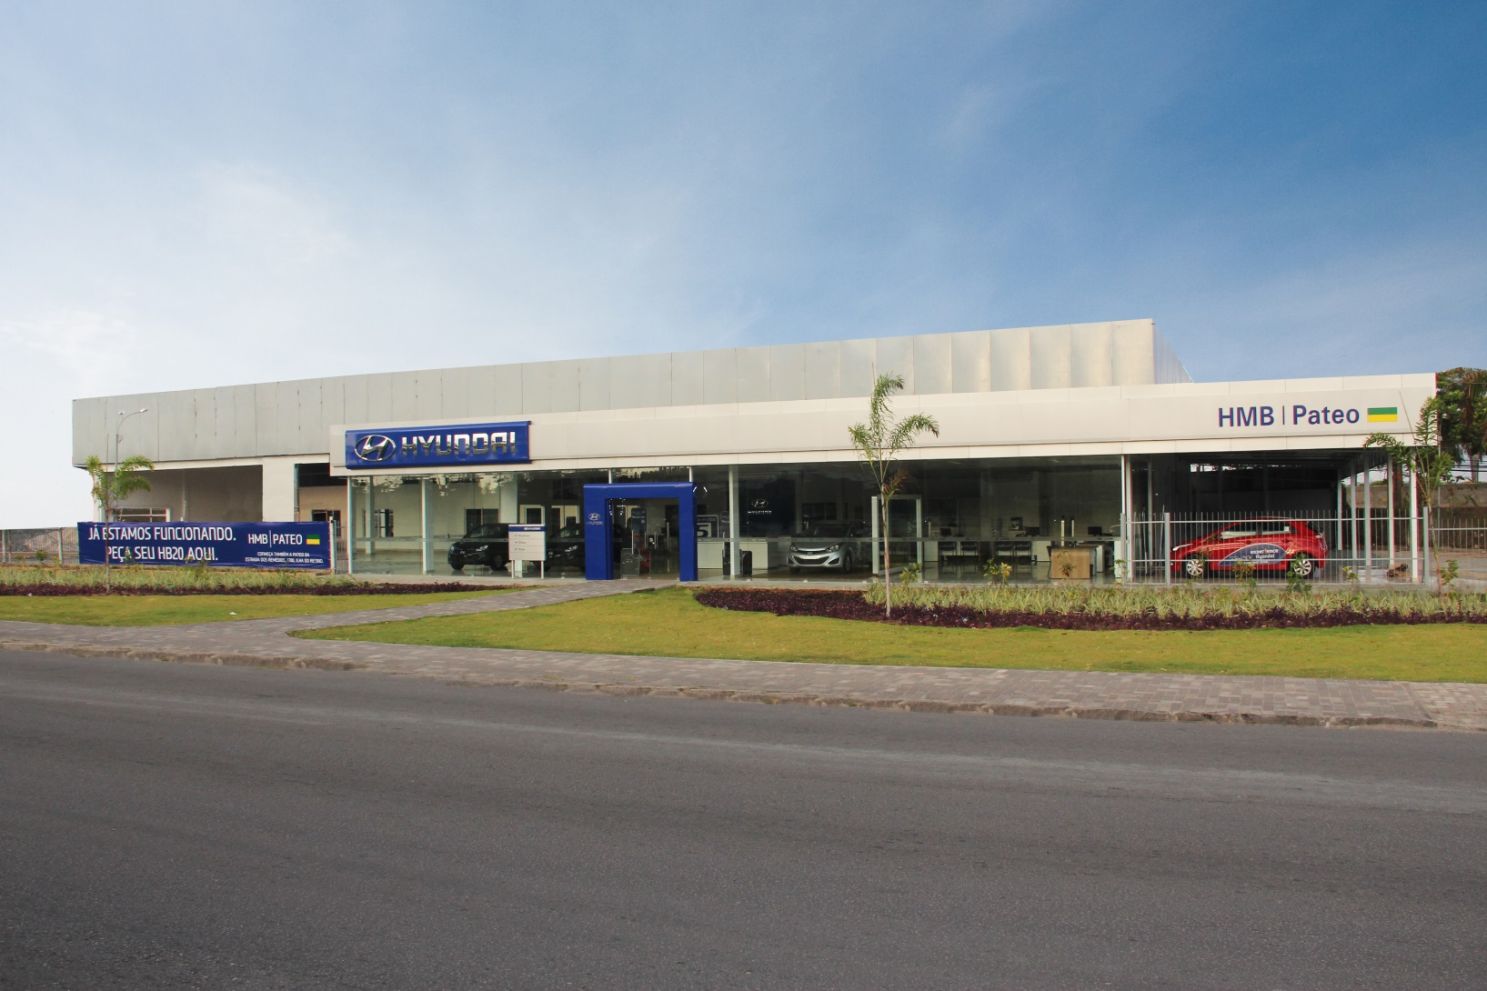
Pateo hyundai
olinda

Slide 18
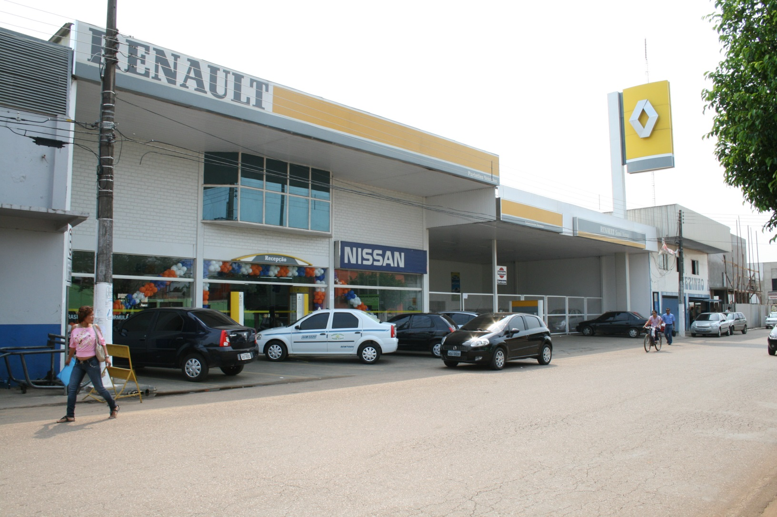
Porto renault
porto velho

Slide 19
Numbers of Cars and Trucks sold Parvi Group
New Retail - 60%
Fleet - 10%
Used - 30%

Slide 20
Total Revenue Parvi Group (in million US$)

Slide 21
Number of Employees

Slide 22
Share of sales by brand

Slide 23
Profit Contribution

Slide 24
Parvi group
Sharing experiences
Challenges of growing a small family owned Dealership into a complex, diverse and big company:
Pillars for a sustainable growth:
  Be a leader on the market in sales
  Be a leader in terms of customer satisfaction
  Be a leader in employees satisfaction
  Be a leader in the relation with the community
  Be a leader in cost efficiency
  Be lean
  Be fast
Clear Goals
Establish processes, but focus on form people
Hire, train and develop people is the only way for sustainable growth
Only internal promotion
Get the benefits of scale but trying to keep simple, lean and fast!

Slide 25
Ok…but,
all I have told you is about the past …

Slide 26
and, all we want to know is …
about the future !

Slide 27
transform the
we all want to
FUTURE
but,

Slide 28
to transform the
FUTURE
it is not easy

Slide 29
because...

Slide 30
“the future is...

Slide 31
...the imperfect
execution
of the unkown,
at the present.”
Prof. Silvio Meira - Brazil

Slide 32
future
present
cenarios
history
past

Slide 33
future
future
future
...
future
future
possibilities
present
present
history
past

Slide 34
What’s the future of the automotive distribution system?

Slide 35
How the new digital world would impact this system?

Slide 36
In the last 5 decades...

Slide 37
we all pass through ...

Slide 38
5 waves of
digital
inovation

Slide 39
hardware
70's
software
80's
network
connectivity
90's
social
mobile
00's
big data
things
10's

Slide 40
these 5 revolutions...

Slide 41
digitalized
and connected
the
SOCIETY

Slide 42


Slide 43

smartphones
WORLD: 50%
+
+
brasil: 80%

Slide 44
and
changed the
rules of the
Game

Slide 45
for everyone
forever

Slide 46


Slide 47
digital
transformation

Slide 48
Changed the
SOCIETY,
definitely...

Slide 49


Slide 50
digital
connected
…into a network
[and all its flows]
mobile
Personal

Slide 51
and there’s a lot more to come:
MOORE’s Law for digital electronic:
every ~2 years, it has
~2x a capacity [performance]
for ~ SAME PRICE...

Slide 52
And what is changing in our industry?

Slide 53
Tesla
autonomus car
there are some initiatives ...
but we mainly still work as we always did
electric car
Truecar.com

Slide 54
“Automotive industry is still a product-oriented business instead of a customer-oriented business...

Slide 55
... mass-production industries are impelled by a great drive to produce all they can.
The prospect of steeply declining unit costs as output rises is more than most companies can usually resist ...

Slide 56
... as in the past, the industry is blinded by its narrow preoccupation with a specific product and the values of its reserves.
It is paying little or no attention to its customers basic needs and preferences”

Slide 57




Slide 58
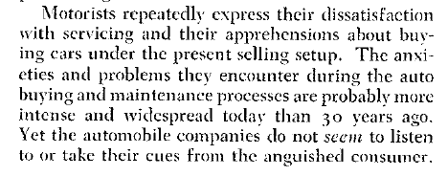


Slide 59
...we[all] tend to continue exploiting knowledge
[products, services and business models] that gives results in our
socio-economic structures,
but that no longer serve our clients and costumers.
roger martin, u. of toronto

Slide 60
"KODAK MOMENT"
founded in 1888, KODAK had 90%
of the photographic film market
at the decade of 1970...

Slide 61

pocket KODAK

Slide 62
the habits of the society are changing...
the act of choosing a car, bying it, manteining and sell it is not what customer demands
we should not only try to sell more cars but give solutions to our customers needs
or we will be replaced of the market from an outsider

Slide 63
ok… but what we are trying to do to face these challenges?
“If you don’t have a strategy, you’re part of someone else’s strategy.”
Alvin Toffler

Slide 64
Parvi group strategies
As a single brand Dealer:
  Persist to be the best in class in each brand and each market;
  Keep the standards of the brand;
  Brand Manager with clear goals;
  Focus on core business: new car sales and service department
What is Centralized:
  Back office
  Finance & Insurance
  Used Vehicles
  Human Resources
  TI – Tecnologie Information
  Marketing
  Digital Experience
  Call Center
  CRM

Slide 65
Parvi group strategies
Our Goal is to provide the whole range of products and services that our customers need for the shopping experience, maintenance and sale of their automobile
Explorer all sales channels
Related Companies with a focus on maintenance of customer:
  Parvi Insurance Broker – 36.000 policies
  Parvi Consorcio – 6.000 clientes/year
  Segsat Tracking Company – 15.000 clients
  Parvi Rental Fleet Company - 2.000 vehicles
  Customer Database Program ~ 1,3 millions of customers updated
  Team of 80 people taking care of them

Slide 66
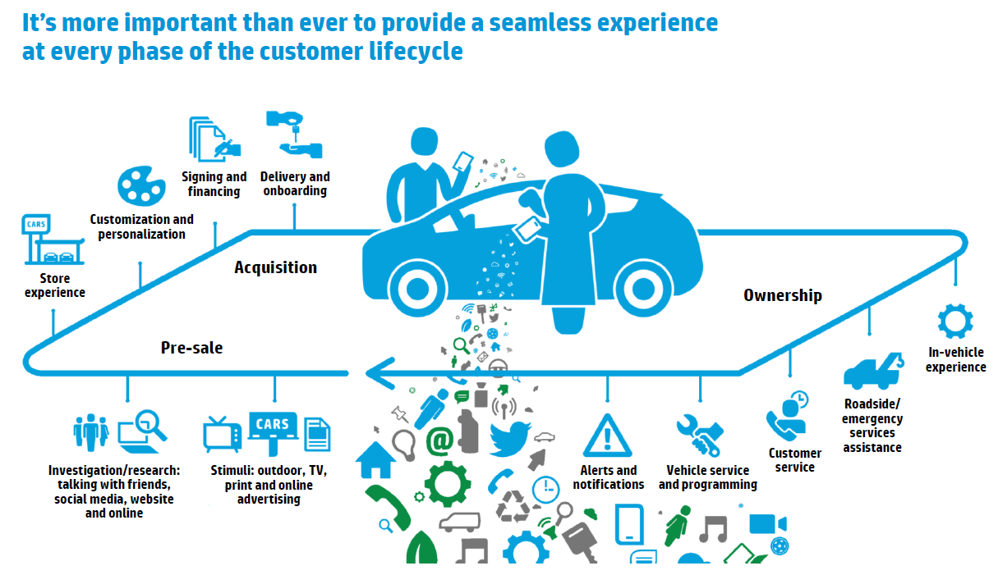
Parvi group strategies

Slide 67
Some parvi iniciatives for the new costumer demands... trying to bring a litlle piece of the future to the present:

Slide 68



On board diagnosis

Slide 69





Drive is a service provided by SEGSAT that with and OBD (on board diagnosis) device and your smartphone and through our plataforms we can track the car and map the behavior of the vehicle and his driver

Slide 70



OBD device connects via bluetooth to the Smartphone

Slide 71
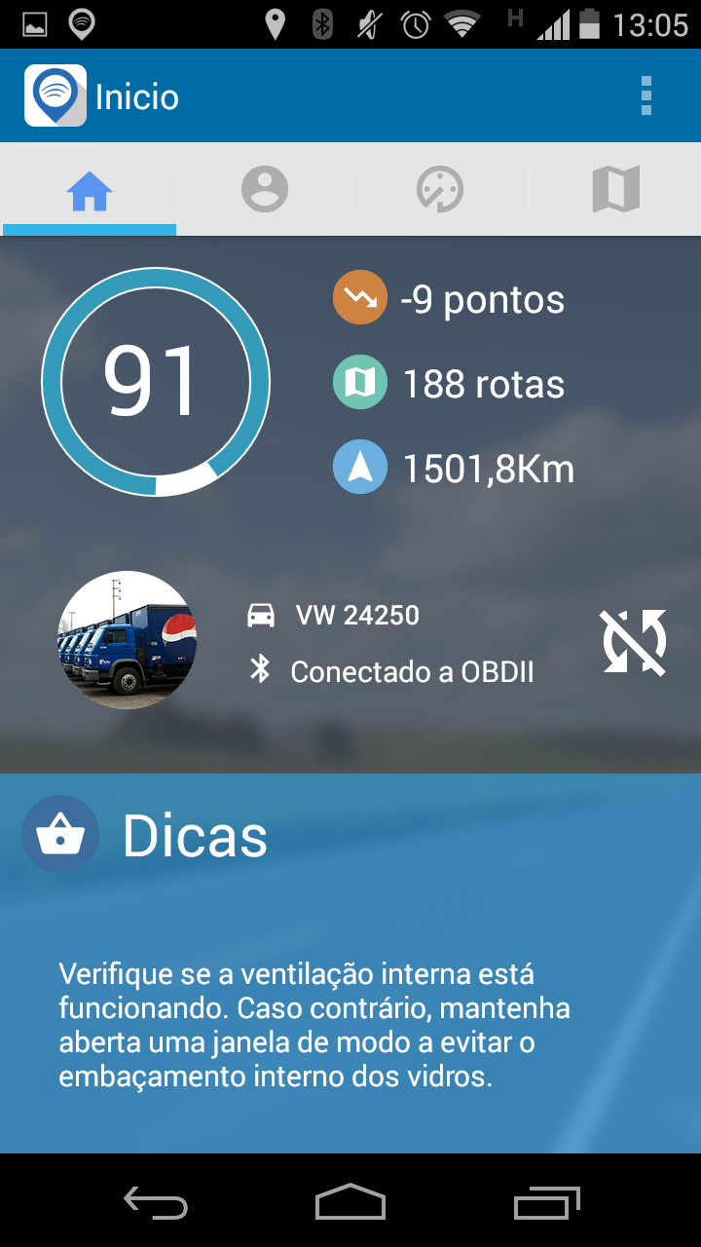
Inicial screen
Driver’s information
Vehicle
Veículo
Status of the connection with OBD
Tips for the driver
Dicas para o Motorista

Slide 72
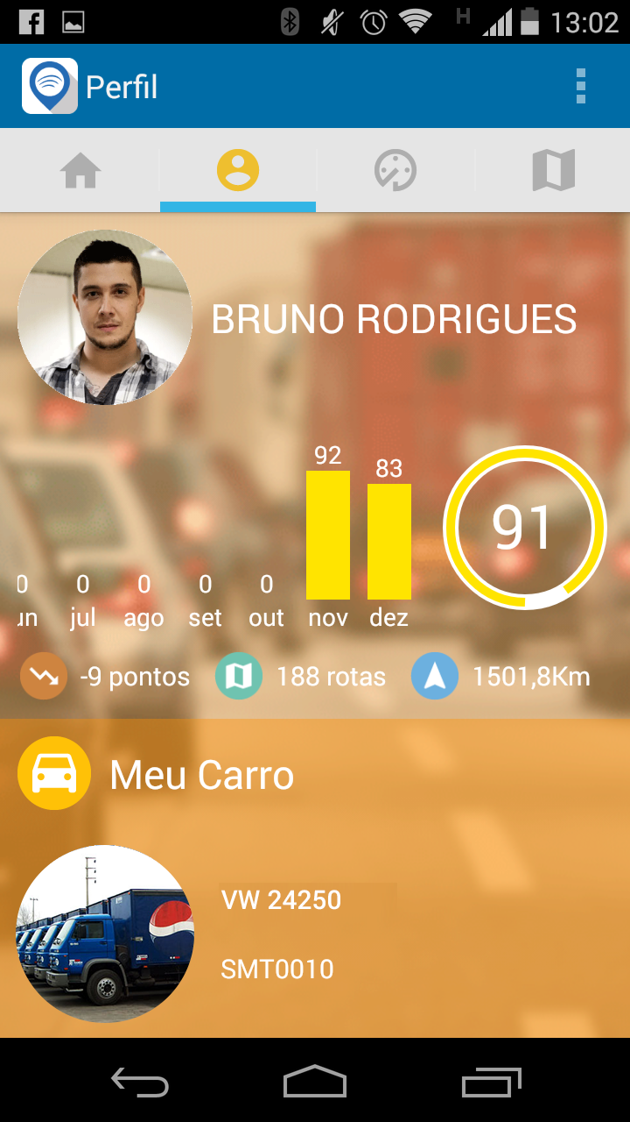
Last route grade
Driver
Last months grade
total grade of the driver
Vehicle

Slide 73
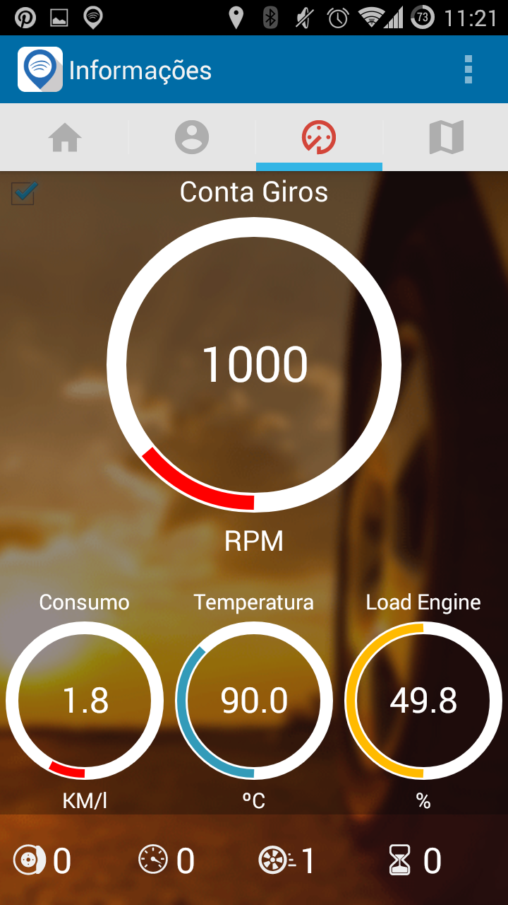
Cockpit Real Time

Slide 74
Error notifications given by the central board of the car
The driver and dealer are noticed!

Slide 75
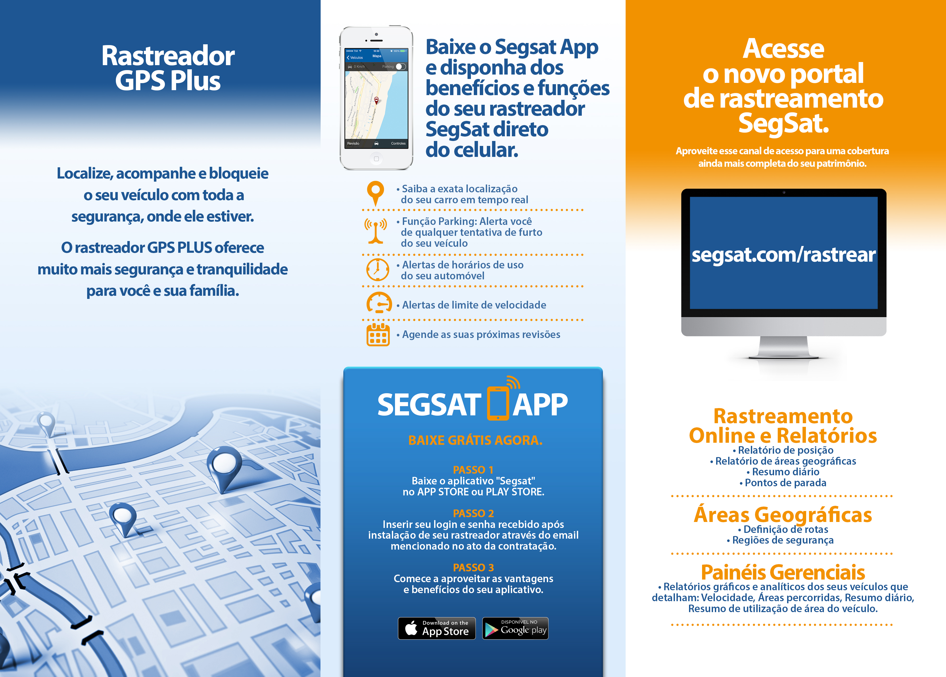
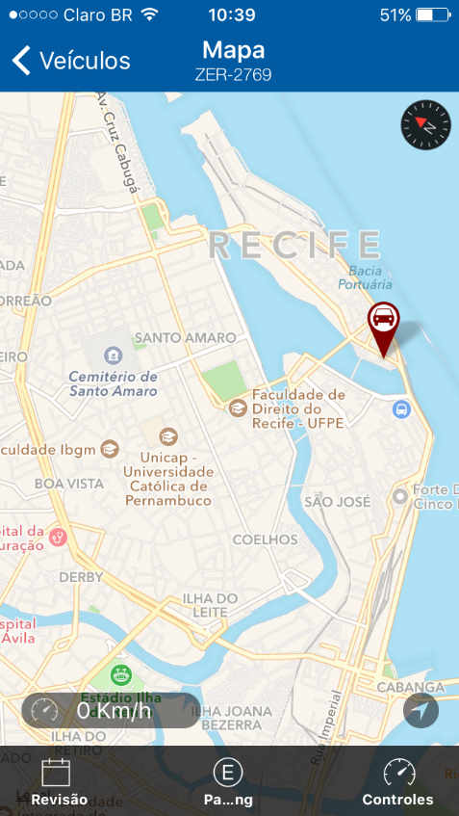
Localização do veículo em tempo real.

Slide 76





Cloud diagnosis
CAR TRACKED,
CLOUD DIAGNOSIS,
BEHAVIOR OF THE VEHICLE
AND THE DRIVER MAPPED
DATA IS SENT TO OUR DATABASE
VEÍCULOS HOMOLOGADOS

Slide 77
New multibrand retail plataform channel:

Slide 78


Slide 79



Slide 80
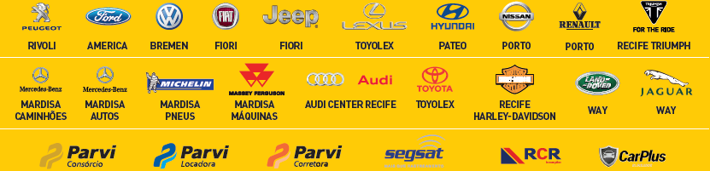
all the products and services that Parvi Group can provide into a single plataform

Slide 81
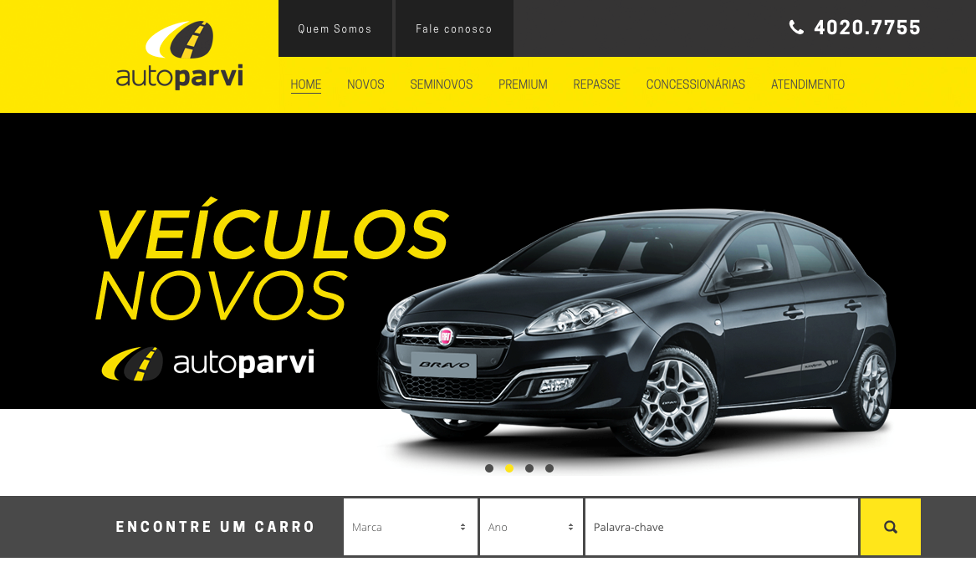

Slide 82
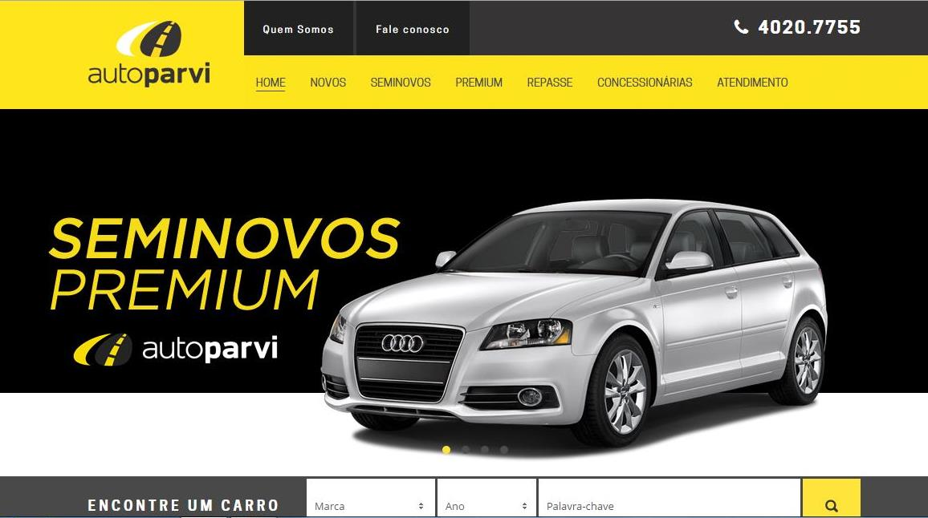

Slide 83
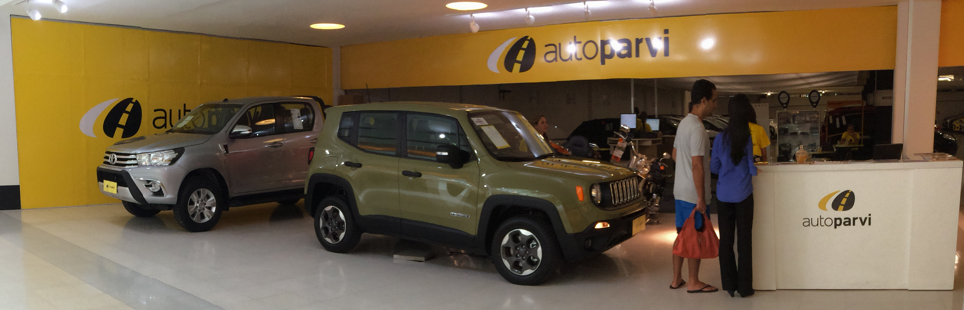
Autoparvi exibition at a Mall
Showroom Autoparvi
Local: Shopping Center Recife
Período: Dezembro de 2015

Slide 84
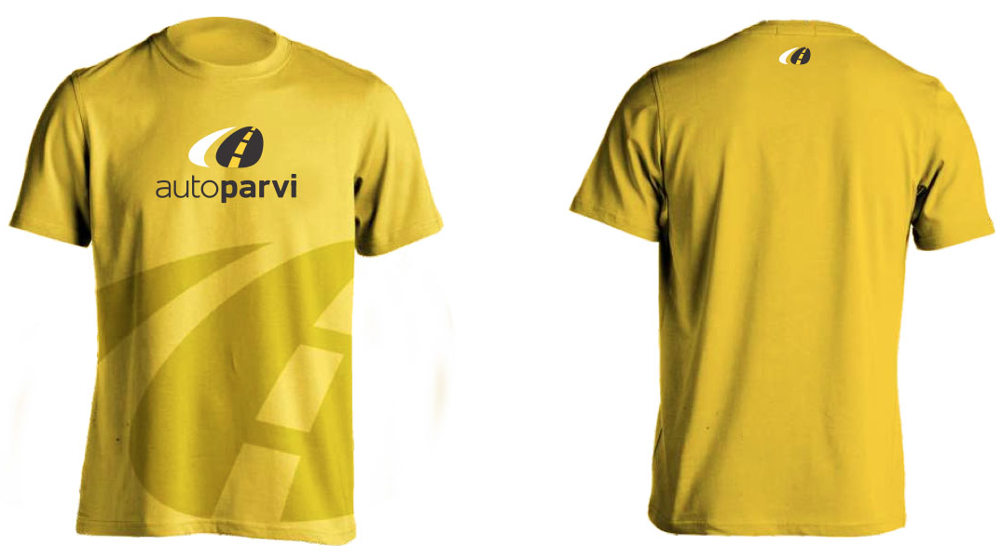

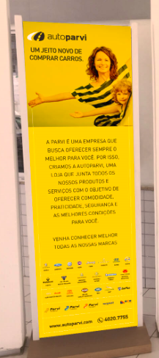


Material
Camisas
Papeleta
Totem
Tabloide de ofertas
Placa de carro

Slide 85
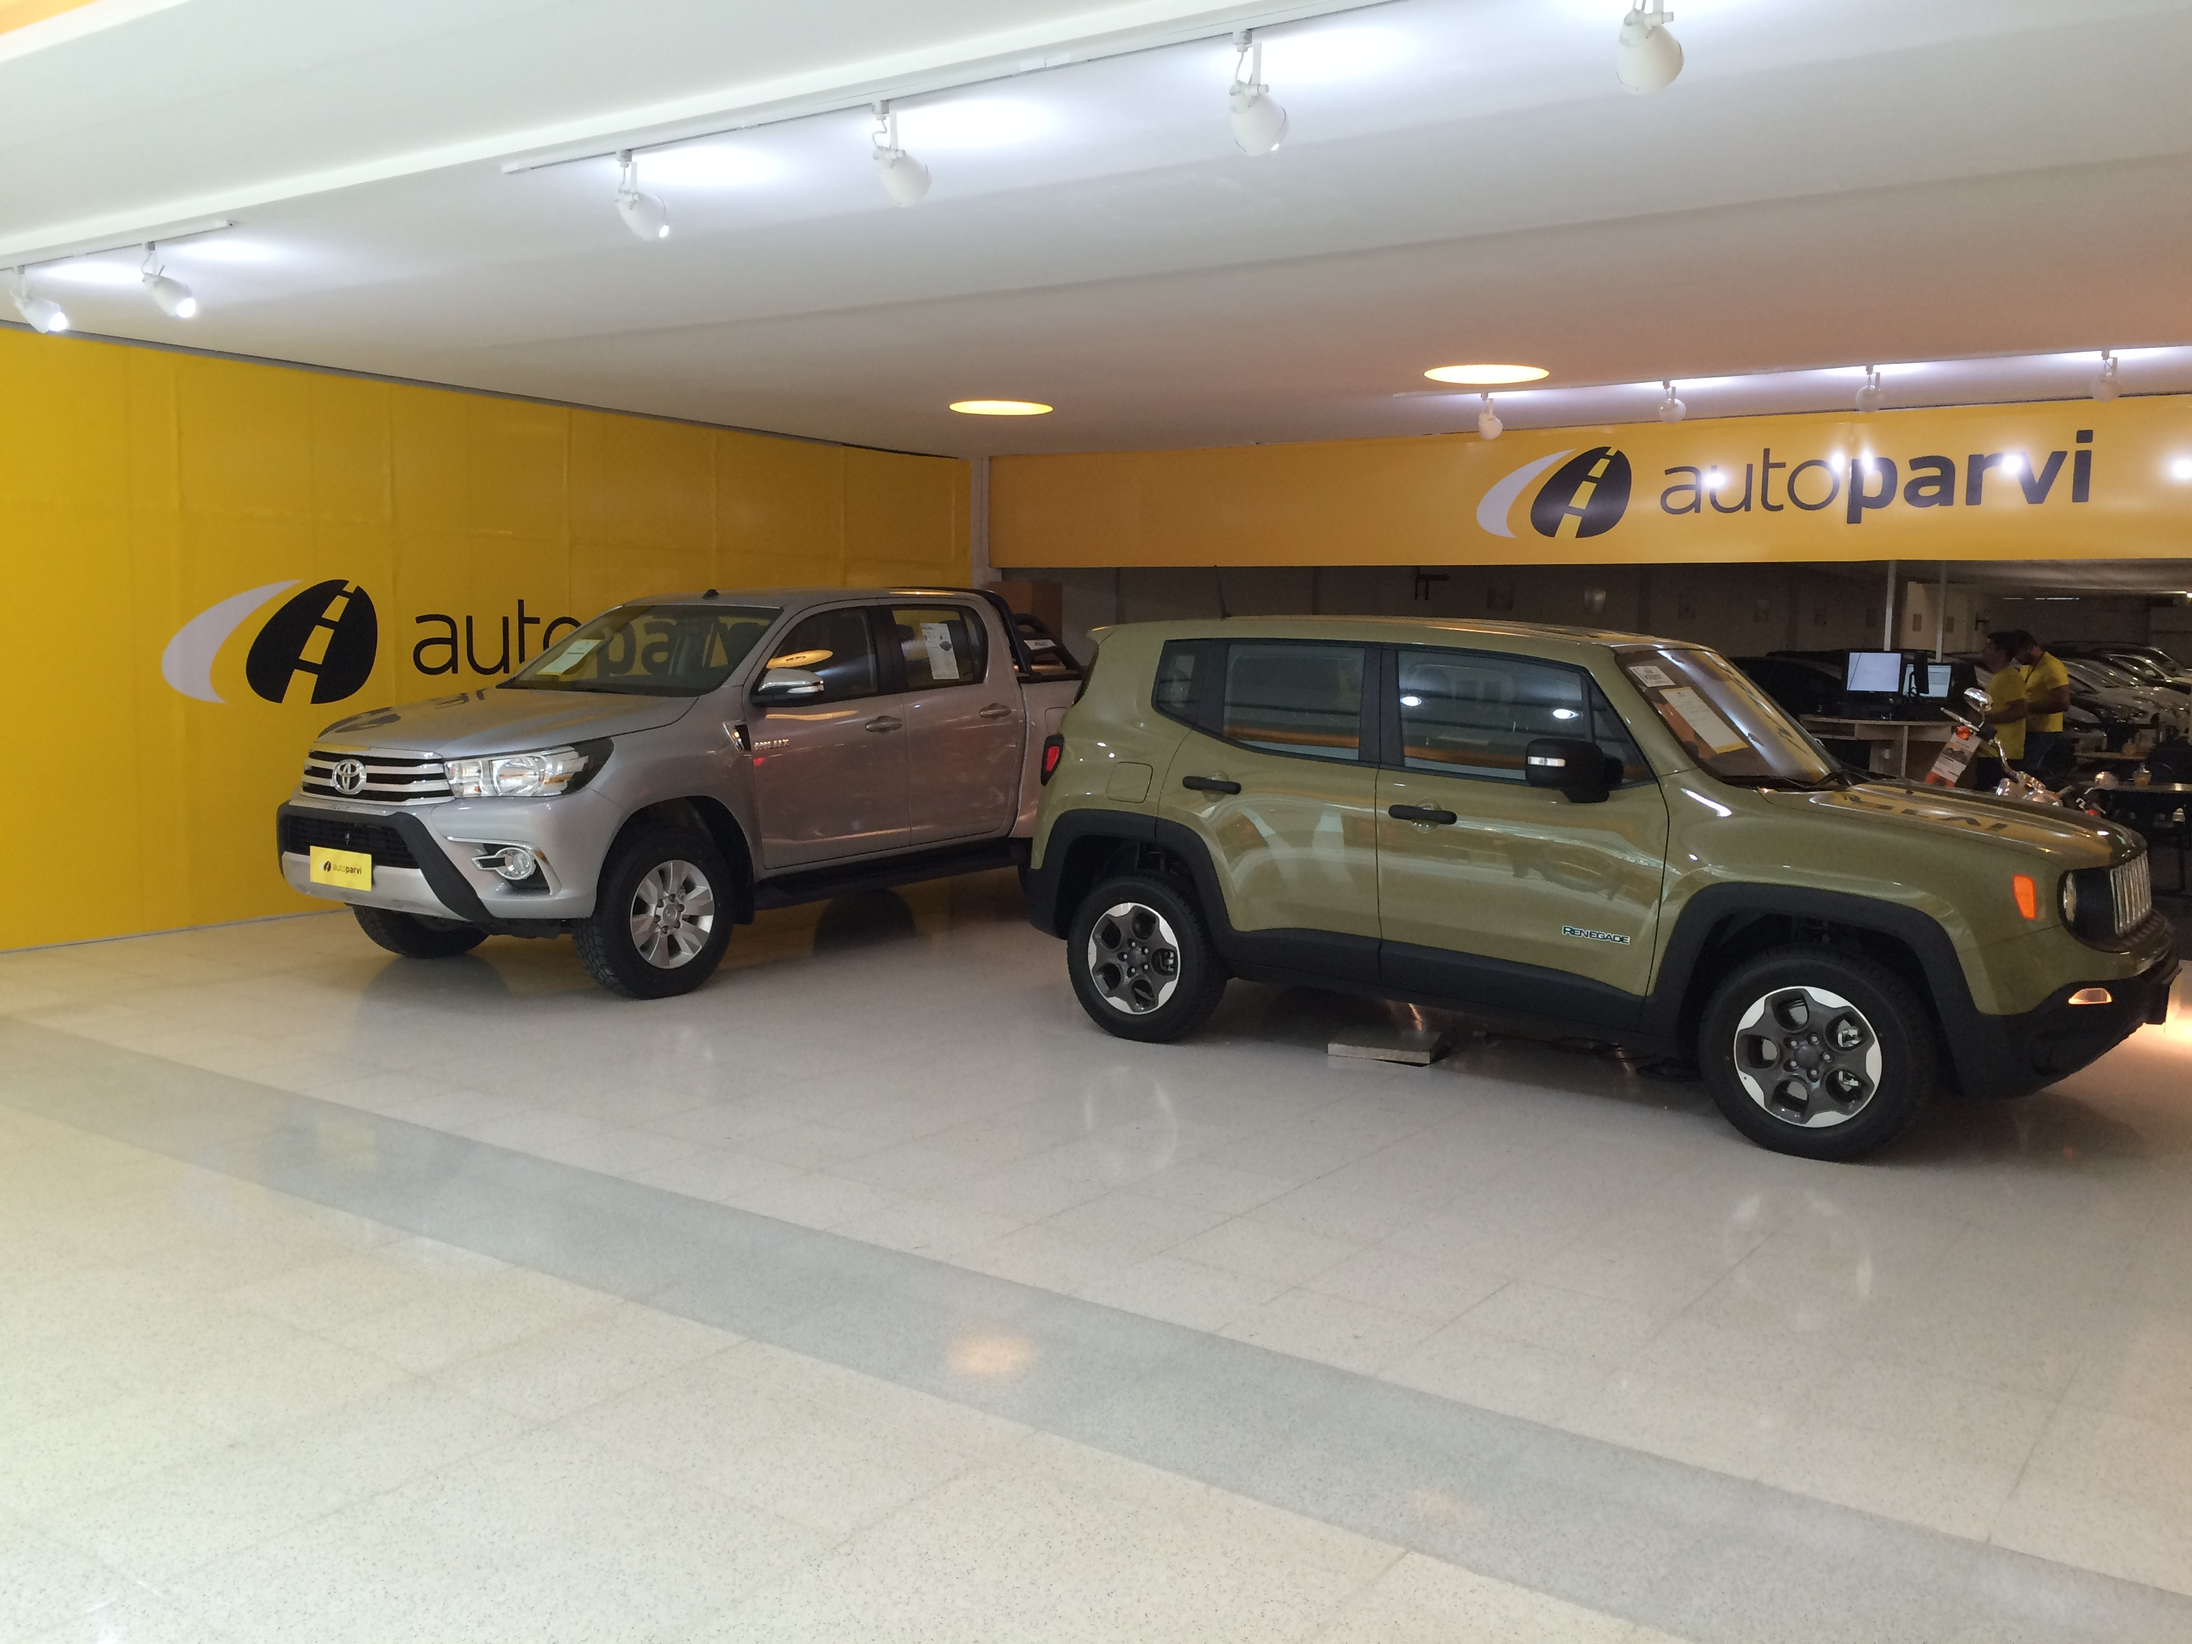
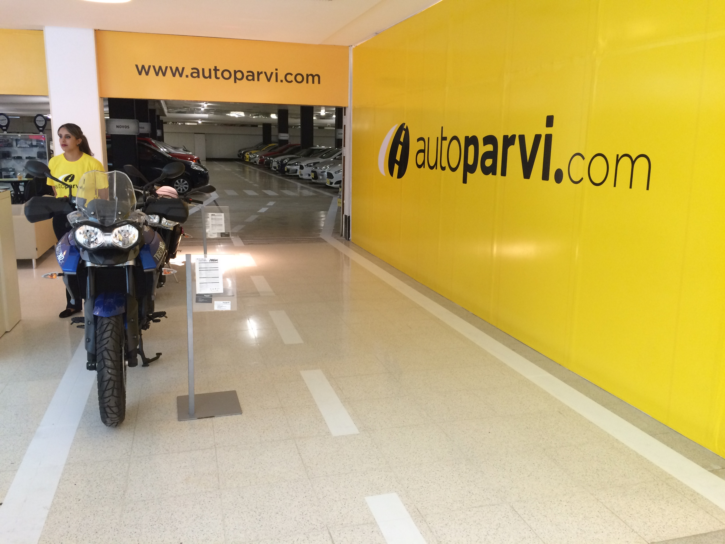
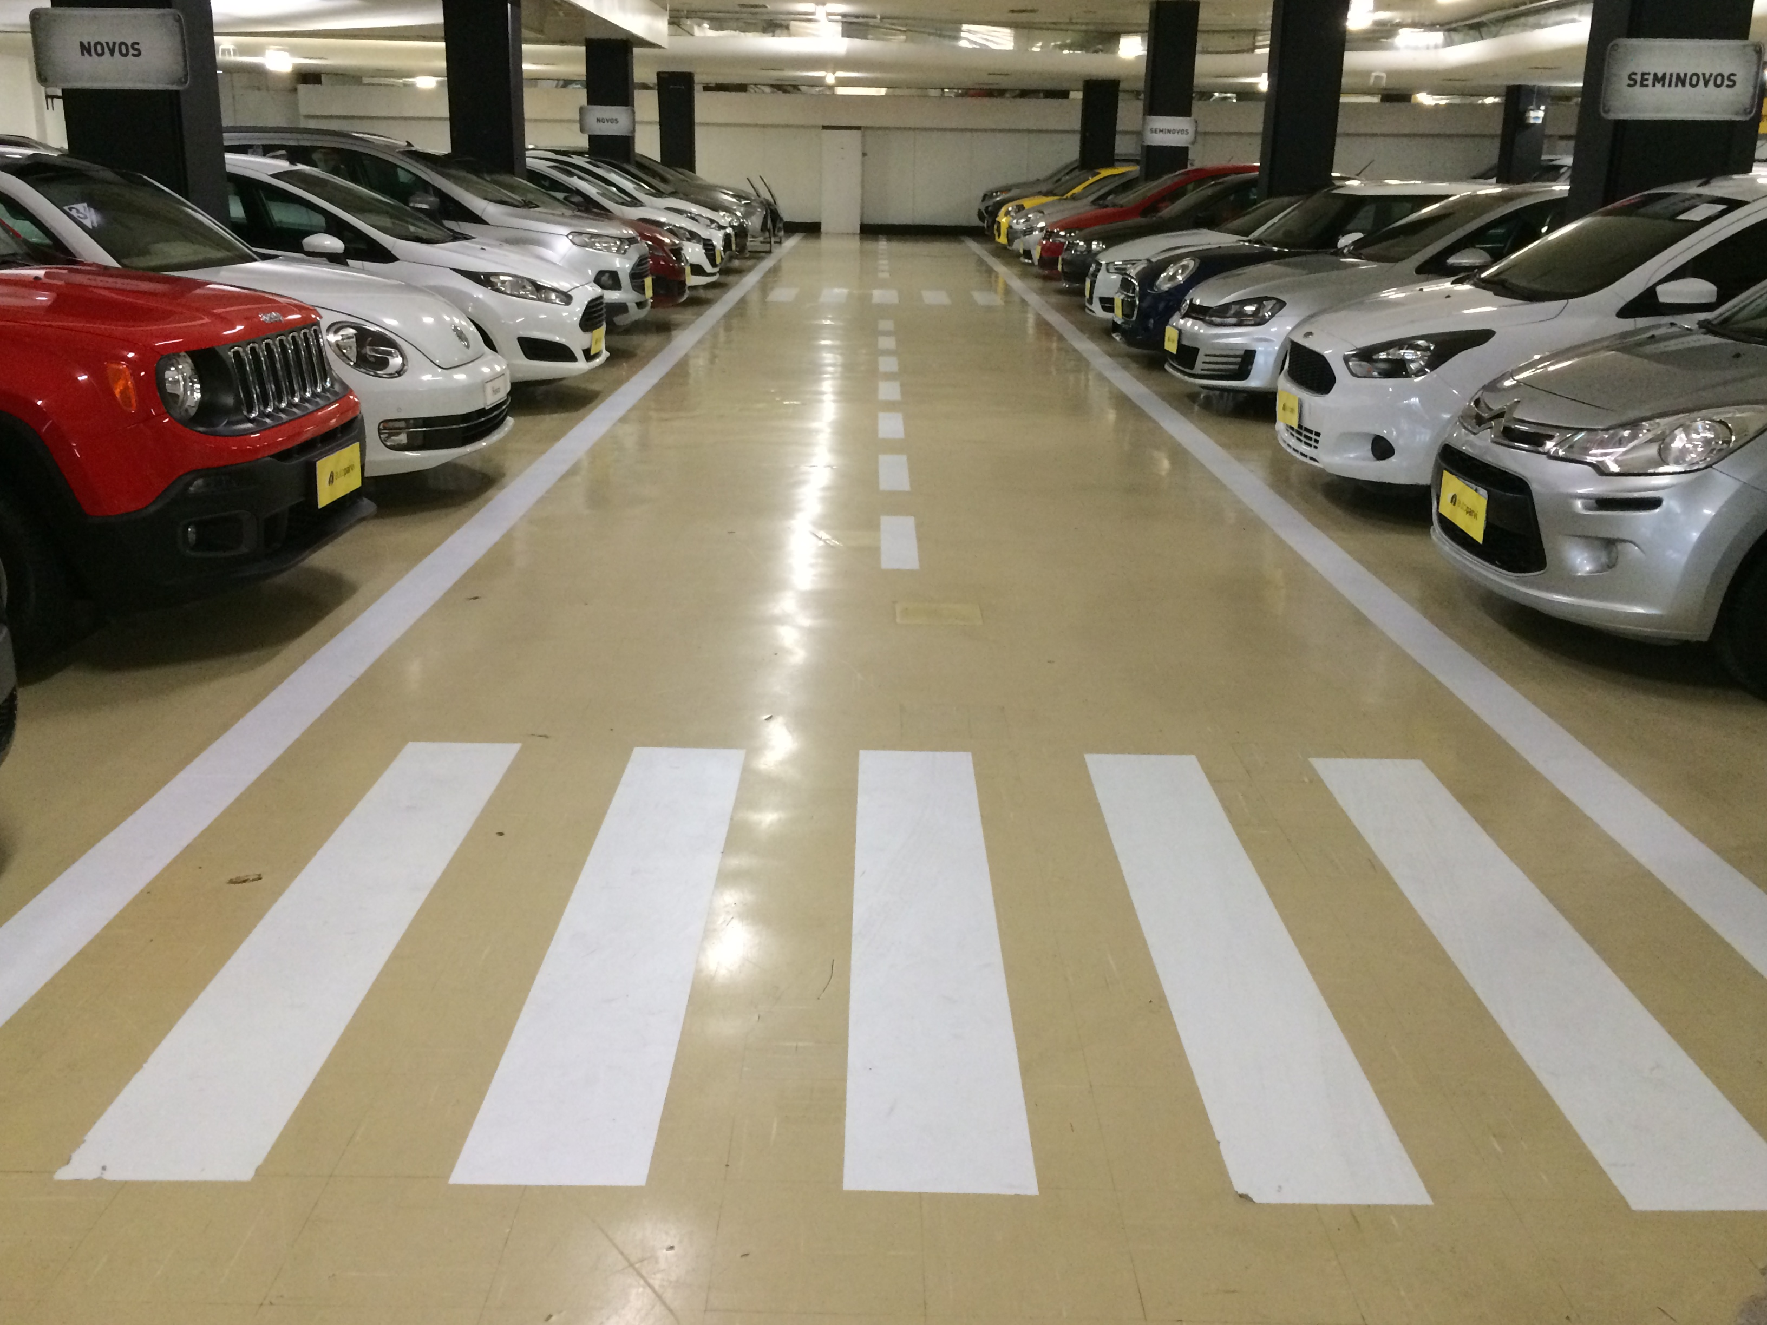
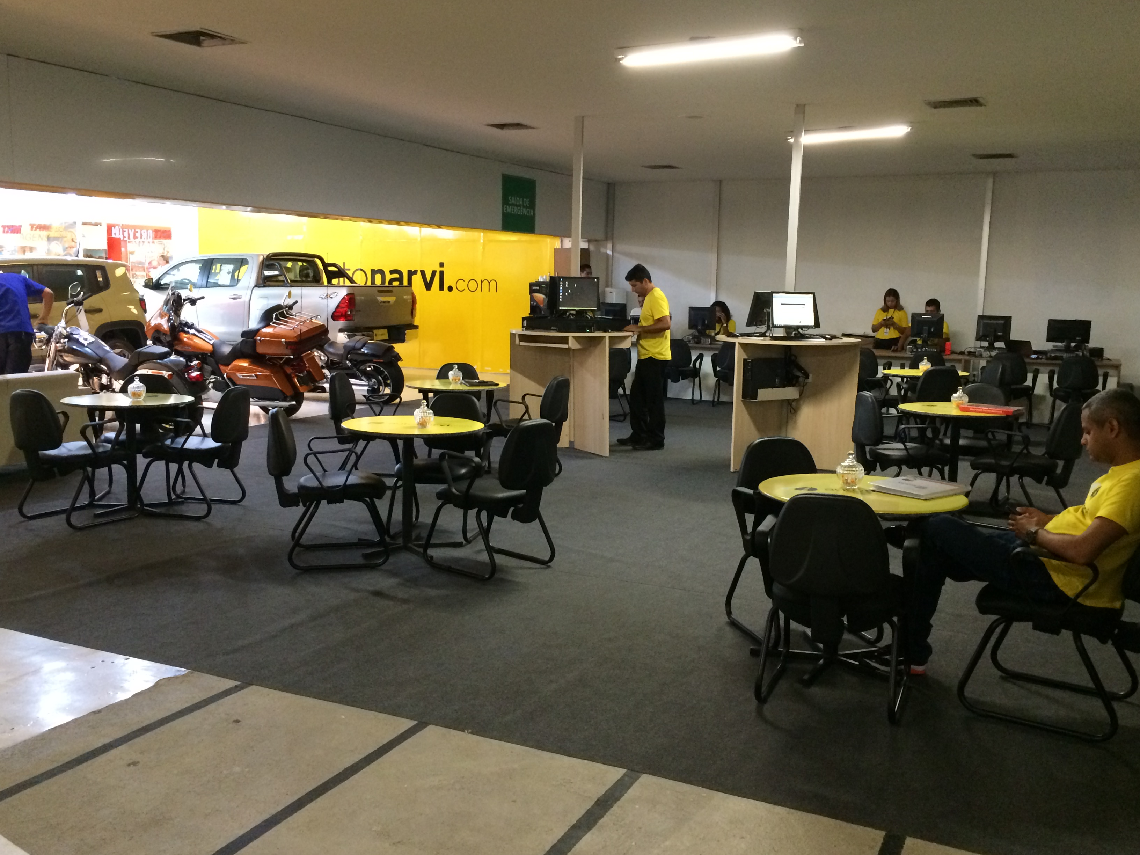
Estrutura

Slide 86
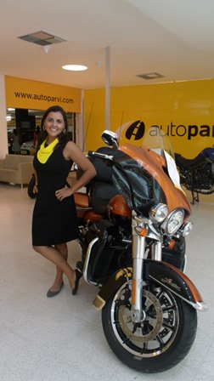
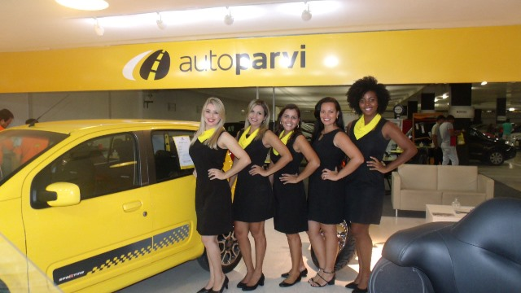
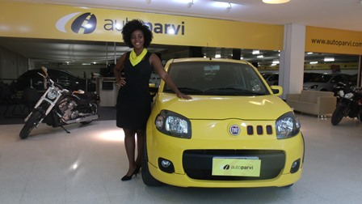
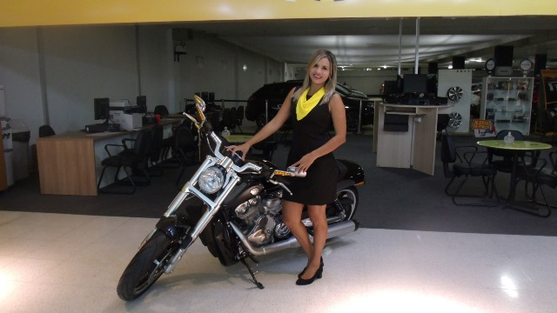
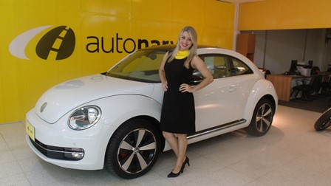
Promotoras aos domingos

Slide 87
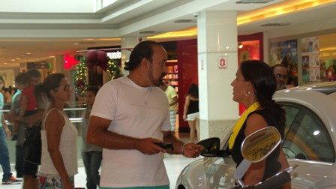
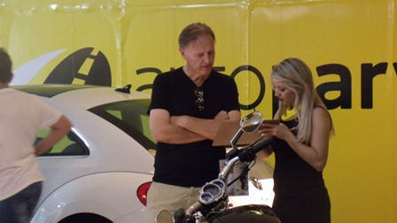
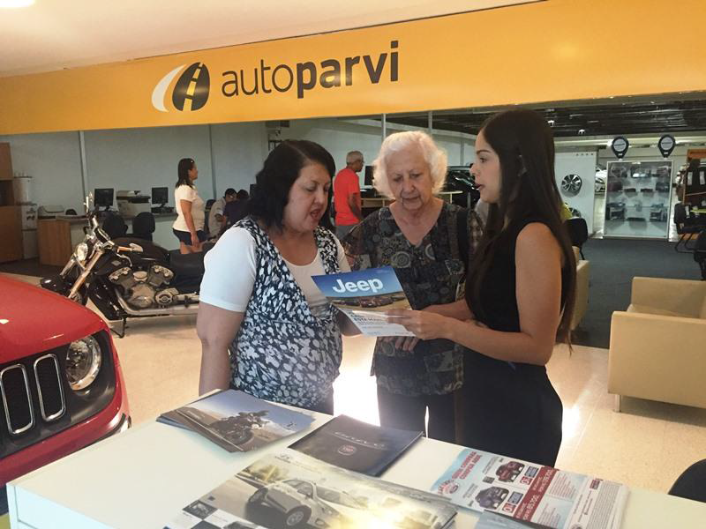
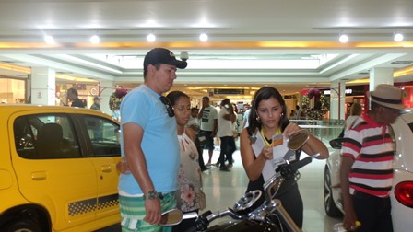
Atendimento

Slide 88
OYDER Automotive Congress 2016
Thanks!
Bruno Schwambach
CEO
Parvi
bruno@parvi.com.br

