Slide 1
Digitalization in Automotive Dealers and Best Practices - INTRODUCTION
Leonardo Buzzavo
President
Quintegia
Leonardo Buzzavo
Ca’ Foscari University of Venice, ITALY
Notes:
[5min tot 5/40]

Slide 2
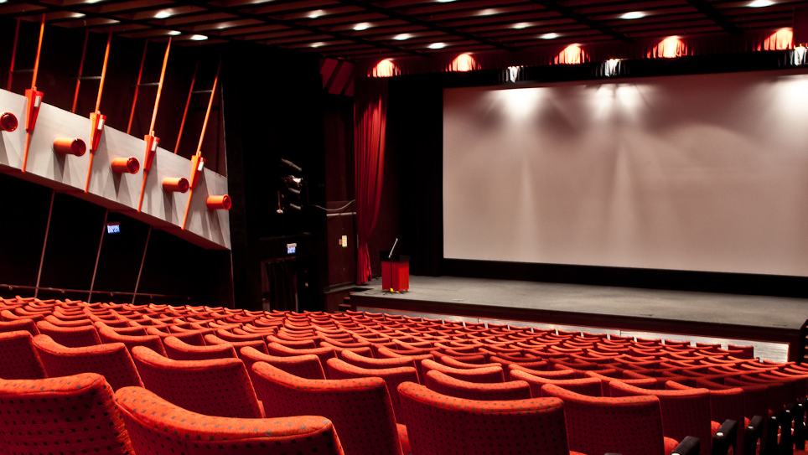
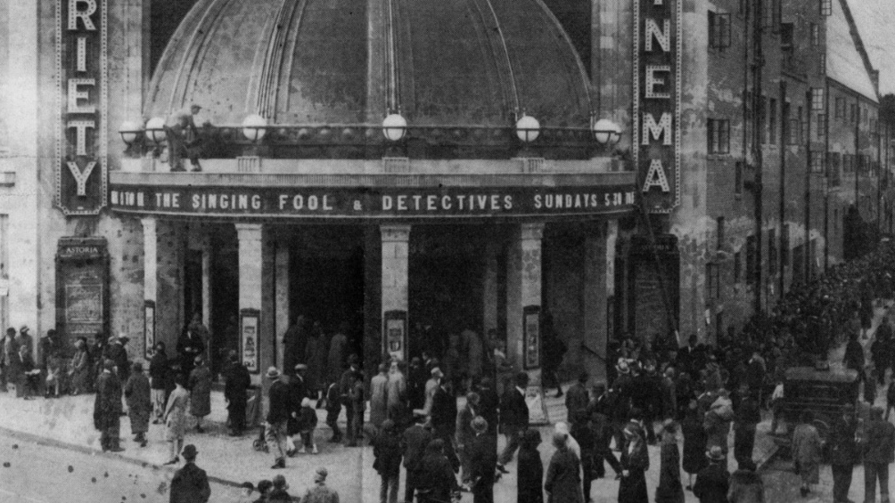
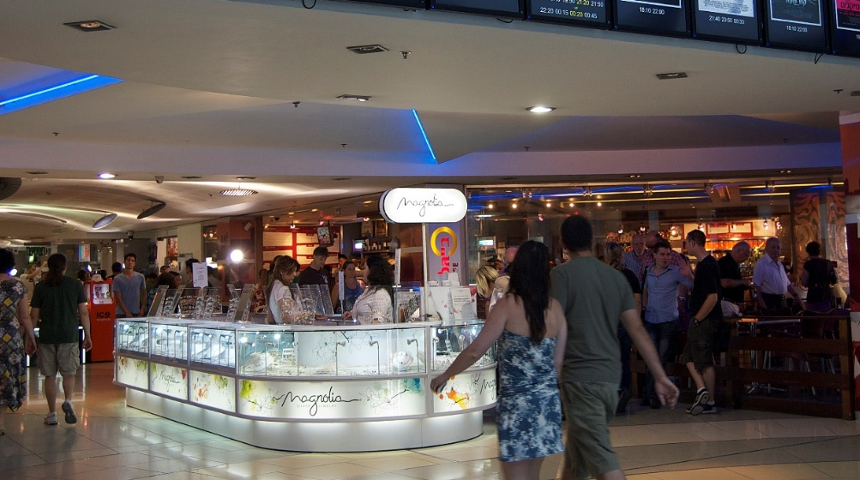
INDUSTRY IN TRANSITION

Slide 3
DEALER DIAGNOSTICS
Notes:
Test Conconi

Slide 4
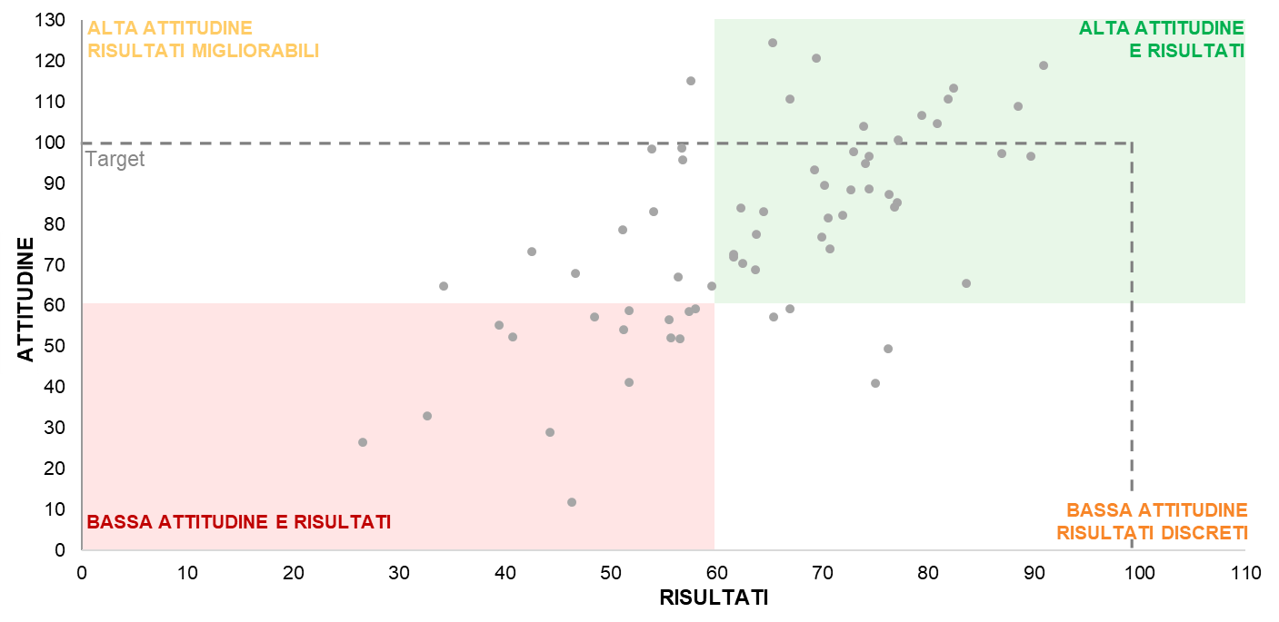
ASSESSMENT AND BENCHMARK
ATTITUDE
PERFORMANCE
Study by
Quintegia
on Brand
Premium
DIGITALIZATION

Slide 5
Customer Journey
GOAL 1
Conversion
Lead generation
Lead Management
& Nurturing
Systems - Processes - People
OEM / Dealer
GOAL 2
Wallet
Marketing
GOAL 3
Loyalty

Slide 6
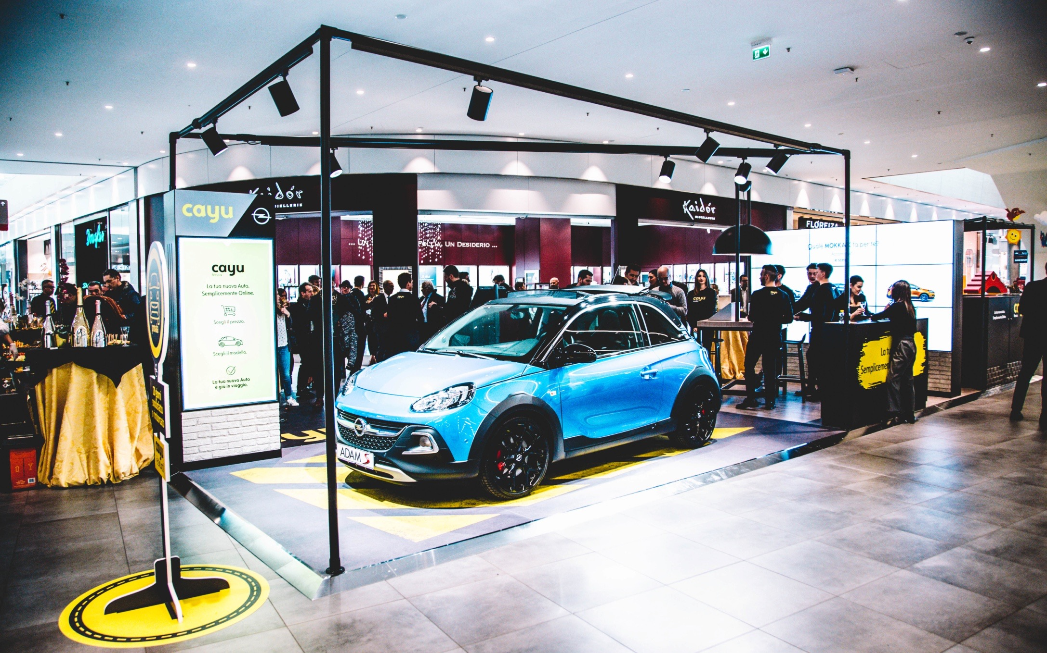
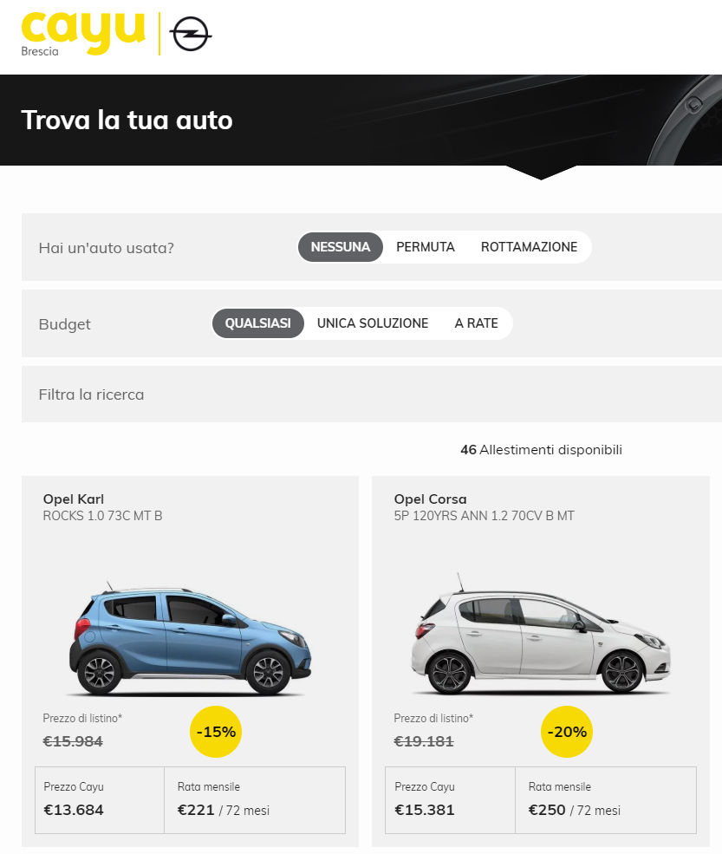
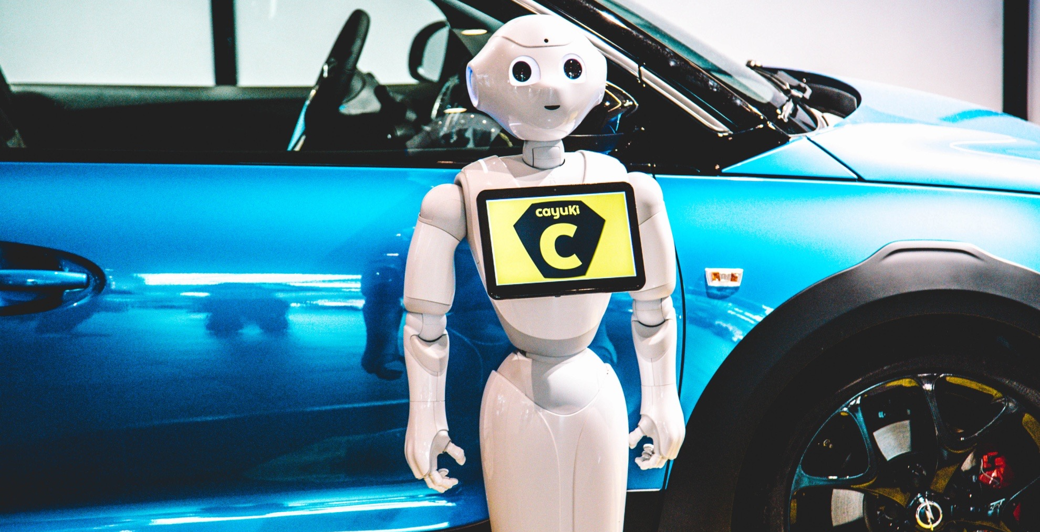
DIGITALIZATION
@
Fonte: CAYU
Barchetti, Brescia

Slide 7
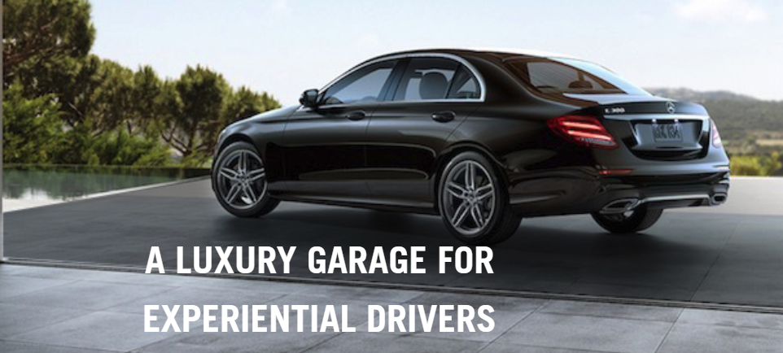
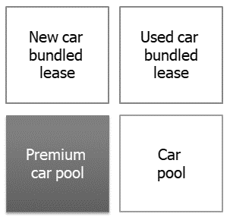
PERSONALIZATION
Fonte: Park Place Select, Texas US

Slide 8
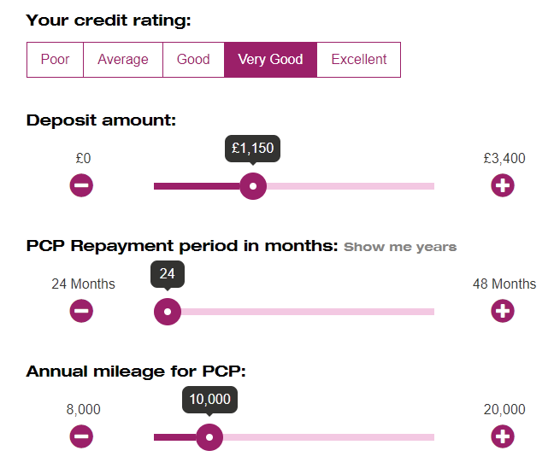
PERSONALIZATION
Fonte: Car Shop, UK

Slide 9
PERSONALIZATION
upgrade
Reward scheme
WITH gamification
+
Info barter
1 to 1
NOTIFICATION
AND OFFERS
CUSTOMER
HISTORY

Slide 10
Omni-commerce
Retail as destination
Remix facility design
Show-room
BECOMES
do-room
(EXPERIENCE)

Slide 11
Less touch-points with human beings
Greatest importance of each touch-point

Slide 12
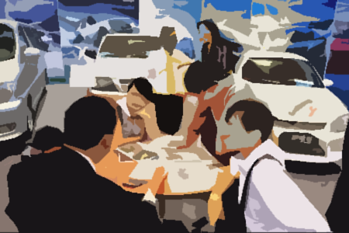
PERSONALIZATION
salesman
selection

Slide 13
Digital company noT digital department

Slide 14
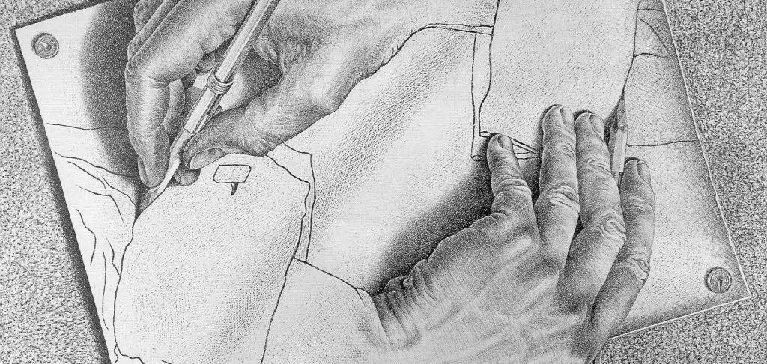
AMBIDEXTERITY: IMPROVING TODAY WHILE LOOKING AT THE FUTURE

Slide 15
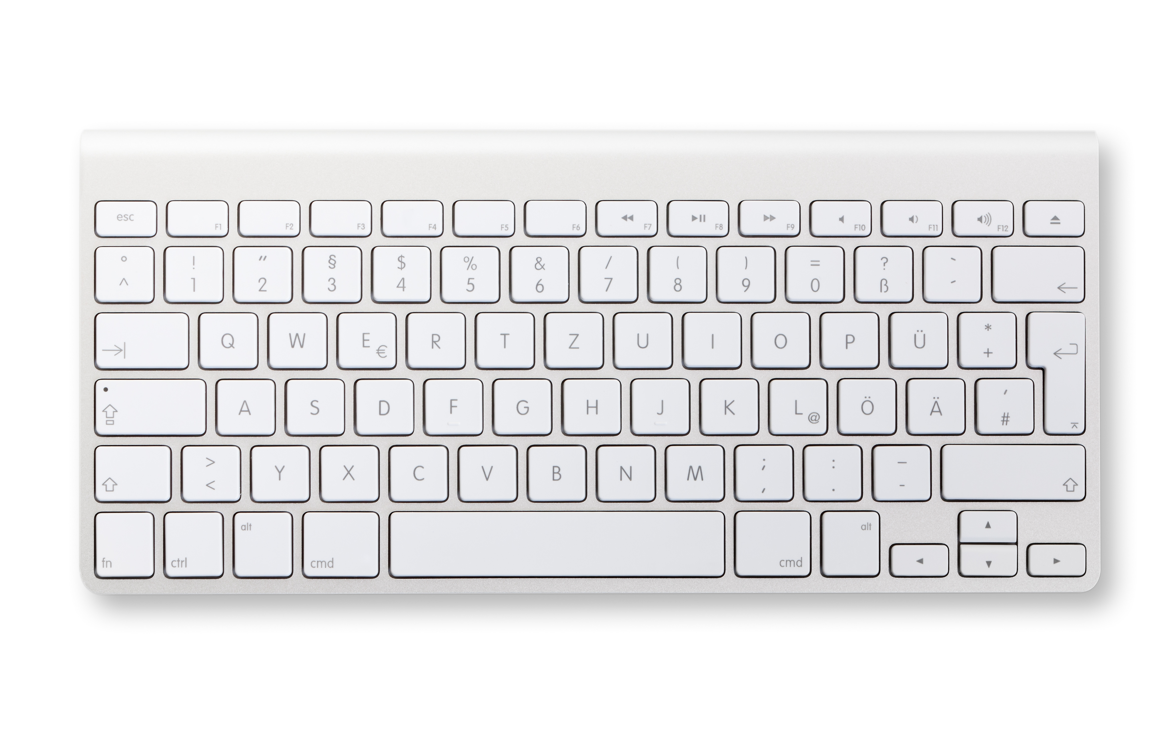

Slide 16
Digitalization in Automotive Dealers and Best Practices - INTRODUCTION
Leonardo Buzzavo
President
Quintegia
Leonardo Buzzavo
Ca’ Foscari University of Venice, ITALY
Notes:
[5min tot 5/40]

